Slide 1
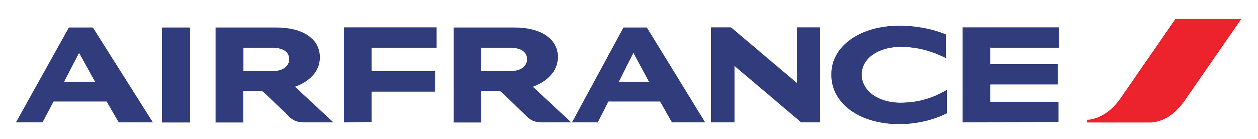
Internet Marketing:
Optimizing Google, Yahoo!, MSN, Overture and Kayak Sponsored Search
Business case presentation
Team 16 – MsBA1

Slide 2
SEM Analysis
Analysing Air France SEM strategy
Viewing publisher’s data from Global and US based
Determine how Air France can increase their market share in the US market

Slide 3
SEM Goals
1
2
3
Increase Revenue
Increase ROA
Improve SEM Strategy

Slide 4




Publisher Competitors
Tailored publisher strategies could perform better for Air France
Variation in bid strategies and costs-per-click

Slide 5
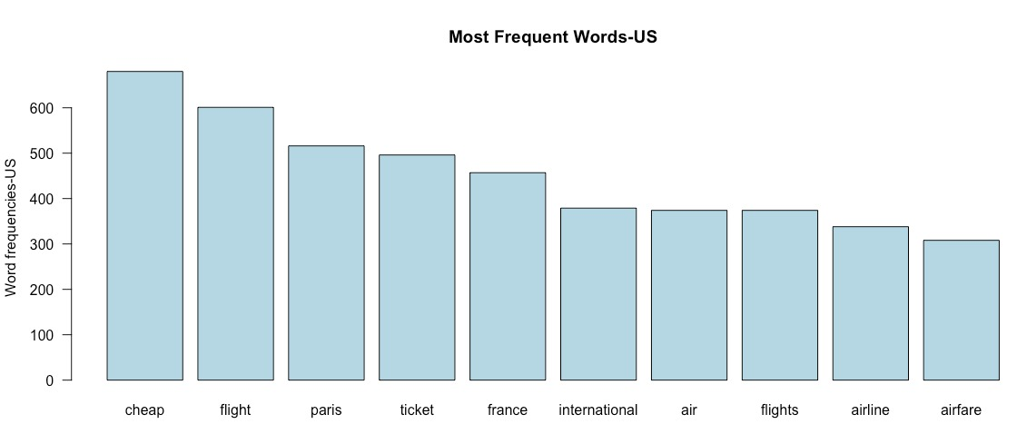
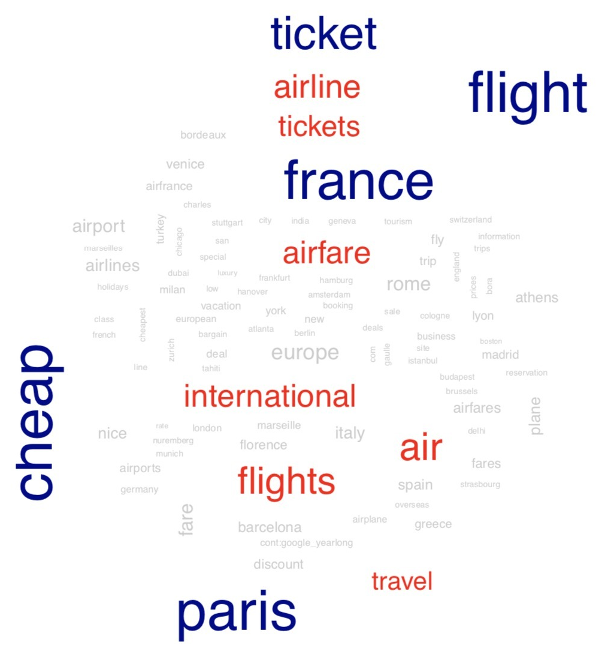
Frequent Words
Most Frequent words US
Branded keywords seem to be the most profitable
Most profitable words include destination
Geo-targeted and generic terms are not as profitable

Slide 6
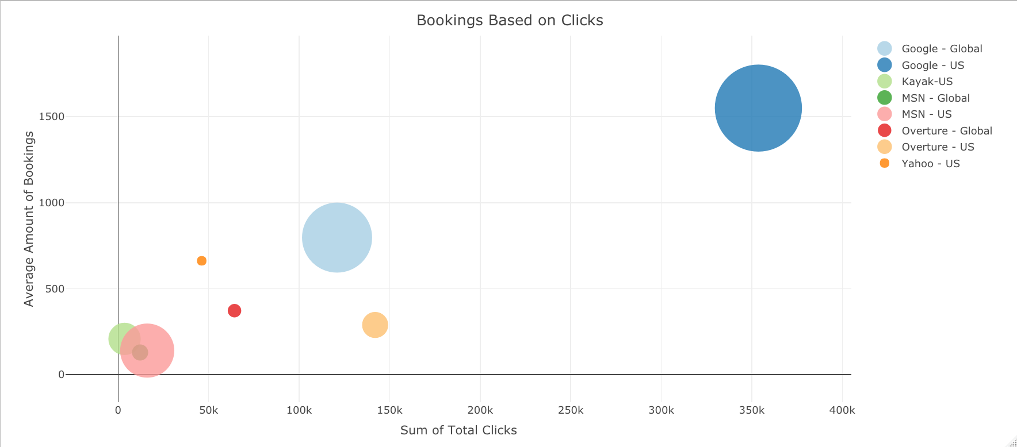
Booking Success
Bookings Based on Clicks
Publishers and their average amount of bookings in comparison to total clicks
A good indicator of SEM strategy performance

Slide 7
…
What are the Costs?
Comparison of Global and US publisher costs
Google is most costly
What should Air France do?

Slide 8
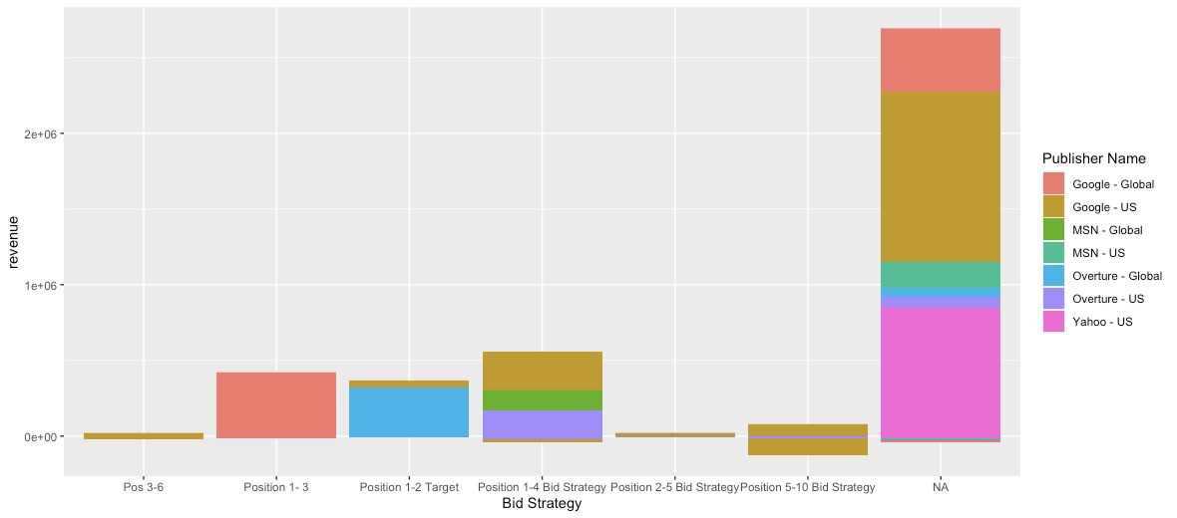
Bid Strategy per Competitor
2e+06
Revenue
1e+06
0e+00
Pos 3-6
Position 1-3
Position 1-2 Target
Position 1-4 Bid Strategy
Position 2-5 Bid Strategy
Position 5-10 Bid Strategy
NA
Bid strategy

Slide 9
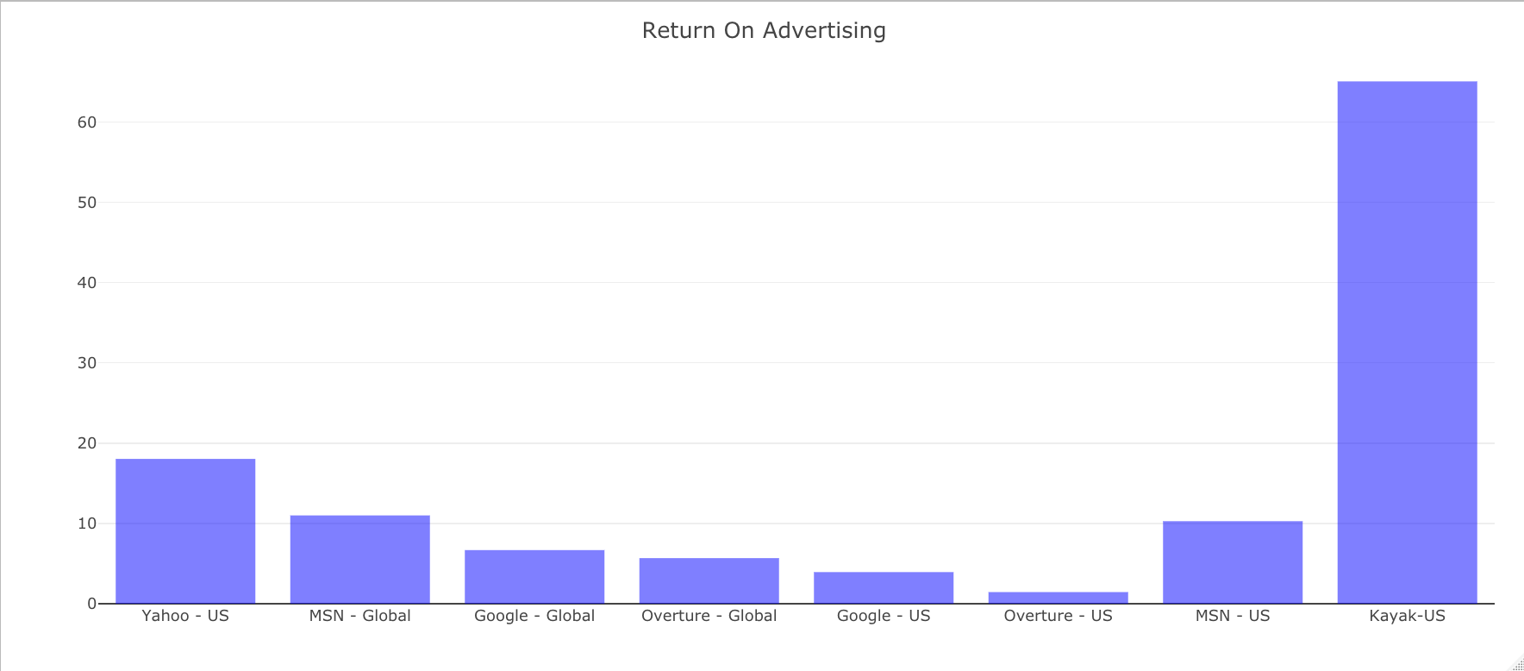
ROA Comparison
Return on Advertising
ROA highlights how much market success the campaigns are producing
Smaller search engines result in much higher ROAs

Slide 10
Recommendations
Publisher | Cost per Dollar Earned ($)
Google – US | 0.25
Yahoo | 0.05
Kayak | 0.01
Increase Budget for Other Publishers
Increase Net Revenue and US market share

Slide 11
Thanks!
Does anyone have any questions?
Sarah Medina
Vi Nguyen
Bogdan Gubarev
Henrik Bjønness

